Slide 1
CSF 2113 Programming for Information Security
Password Testing (CLO 05)
Muhammad Humayoun, PhD
Assistant Professor
mhumayoun@hct.ac.ae
Abu Dhabi Men’s College
This module is based on the course: Learning Python Web Penetration Testing, www.lynda.com

Slide 2
Table of Contents
Password Authentication and Attack
Hands on
Web-based Authentication
First password tester – Basic Authentication
Login forms testing
Cracking Unix Passwords

Slide 3
Security Levels
File Systems
Clear text
Dedicated Authentication Servers
Clear text
Encrypted
Password + Encryption = bf4ee8HjaQkbw
Hashed
Password + Hash function = aad3b435b51404eeaad3b435b51404ee
Salted Hash:
(Username + Salt + Password) + Hash function =
e3ed2cb1f5e0162199be16b12419c012
Windows uses this
(loosely speaking)
Unix OS uses this
(loosely speaking)

Slide 4
Password Authentication
Process of verifying users credentials
Access to system is provided to users with correct username and password
User has a secret password
System checks it to authenticate the user
Vulnerable to eavesdropping when password is communicated from user to system
How easy is it to guess the password?
Easy-to-remember passwords tend to be easy to guess
Password file is difficult to keep secret

Slide 5
How password attack works
Password attacks use Fuzzing
Dictionary Attack
Quick technique that tries every word in a specific dictionary
Hybrid Attack
Adds numbers or symbols to the end of a word
Brute Force Attack
Tries all combinations of letters, numbers & symbols
Popular programs for Windows password cracking
LC4
Sam Inside
Crack
John the Ripper (JTR)
LOphtCrack

Slide 6
Impact on Security
Simple hacking tools are available to anyone who looks for them on the Internet.
Tools such as LOphtCrack allow admittance into almost anyone's account if a simple eight-digit password is used. …. This was the kind of tool which we found, nothing terribly sophisticated.
-- Richard Clark, Presidents Advisor on Cyber Security (2001-2003)

Slide 7
Password testing/cracking
Password cracking is the most common type of brute force attack
Exploiting the fact that users choose weak passwords to remember
Based on dictionary of well-known common used passwords
One such excellent list is based on RockYou.com compromise
In December 2009, RockYou.com was hacked, and a list of usernames and passwords was exposed to the Web, in plain text.
Also, hybrid (dictionaries with variation of alphanumeric words)
Most common passwords:
https://en.wikipedia.org/wiki/List_of_the_most_common_passwords
http://www.passwordrandom.com/most-popular-passwords

Slide 8
Different approaches in detail
Vertical scanning (username/all passwords)
Horizontal scanning (different usernames for common passwords)
Diagonal scanning (different username/password each round)
For web-based/Network based attack:
Three dimension scanning (horizontal/vertical/diagonal + distributing source IP)
Four dimension scanning (horizontal/vertical/diagonal + distributing source IP + time delay)

Slide 9
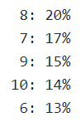
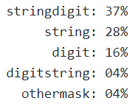
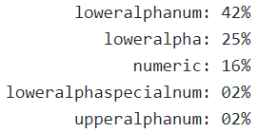
Lessons from RockYou.com compromise
Most of the passwords have length 6 to 10 characters.
The majority of passwords have lower alphanumeric character-set.
There is no obvious minimum or maximum password complexity.
Analyzed passwords tend to follow a simple masks "string followed by digits“
Details:
Length
Character-set:
Simple Masks
Source: https://github.com/iphelix/pack

Slide 10
Password Policy and Account Locking
Password policy is a set of rules that defines the minimum password quality
Length of passwords
Case sensitivity: mix of lower and upper case
Characters allowed: characters, numbers, and symbols
Reuse of past passwords: How many previous passwords you can’t use
Can’t use blacklist passwords (which are very easy to crack, like, “password”, “123456”, etc.)
Need to set password rotation frequency
Account locking after X numbers of wrong attempts

Slide 11
Hands on: First password tester – Basic Authentication
Basic authentication
Creating our first password brute forcer targeting the basic authentication method
Test the script against a victim web application

Slide 12
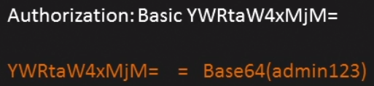
Basic Authentication
Basic authentication is one of the simplest techniques for enforcing access control to web application resources.
Implemented by adding special HTTP headers
Insecure by design, as the credentials are being sent encoded with Base64 method, which can be reversed easily
For instance, we can see how basic authentication header looks like:

Slide 13
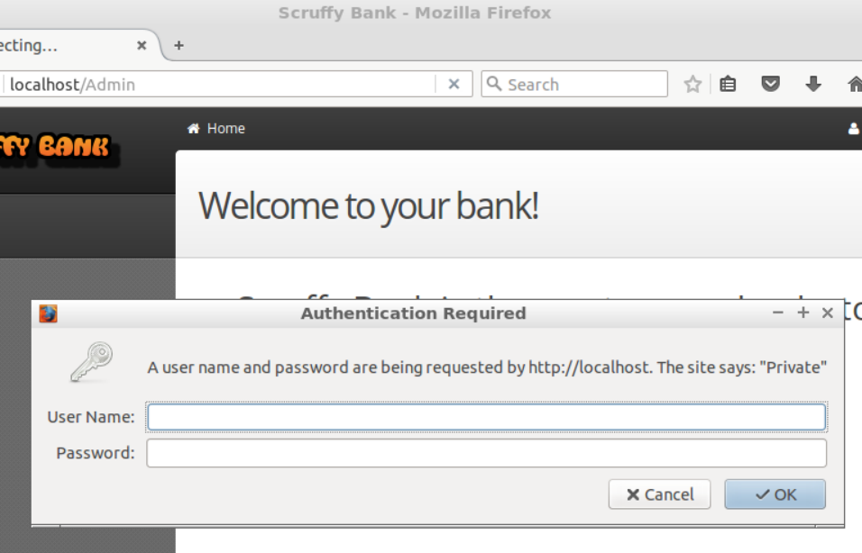
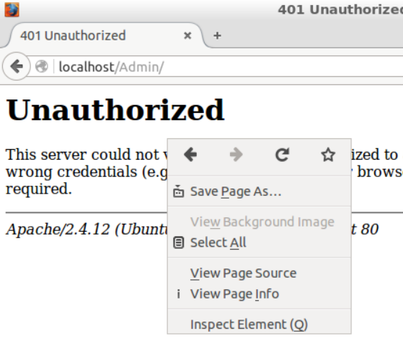
How to check the authentication method

Slide 14
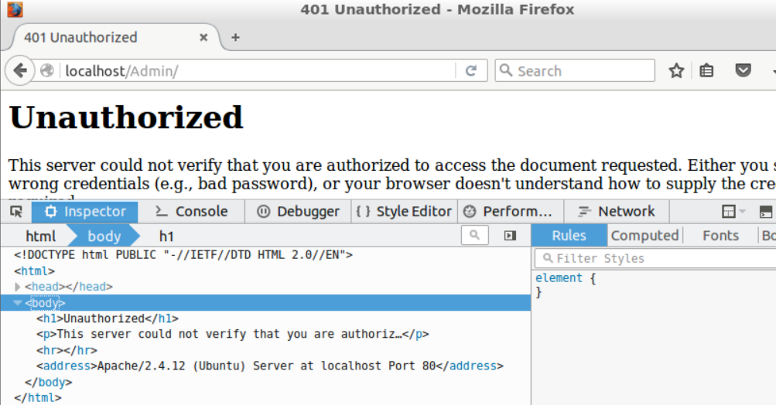
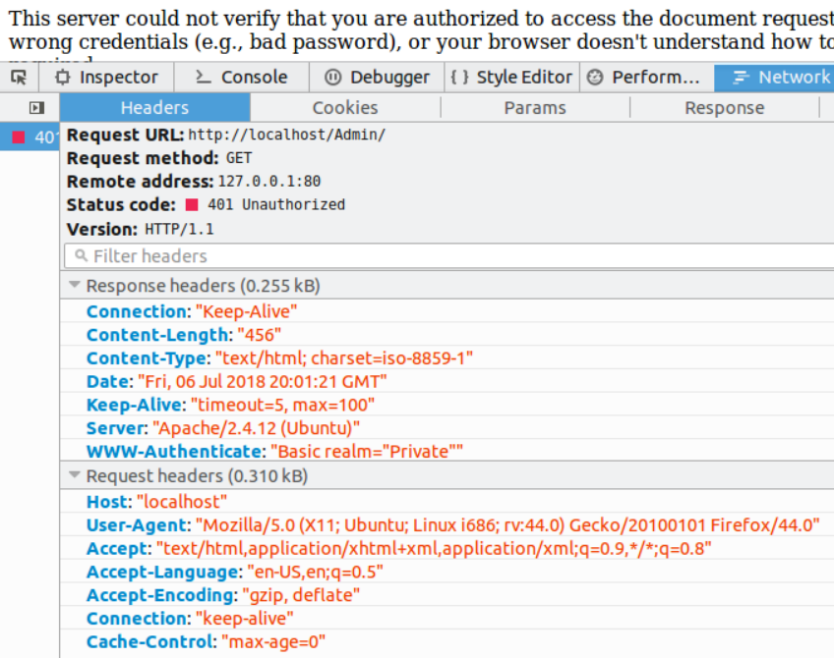
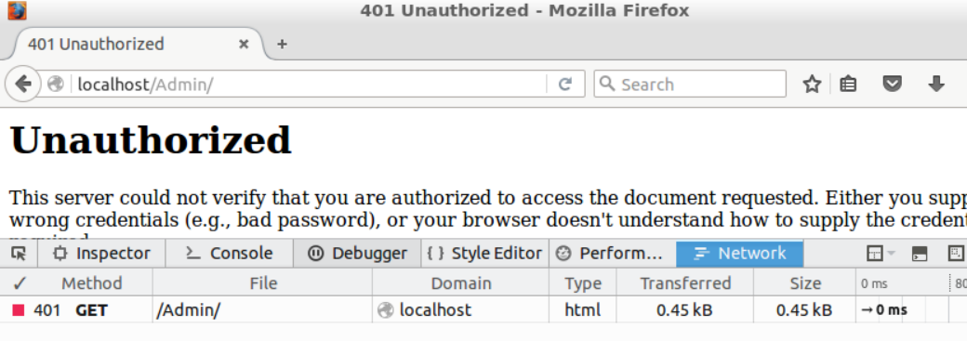
How to check the authentication method

Slide 15
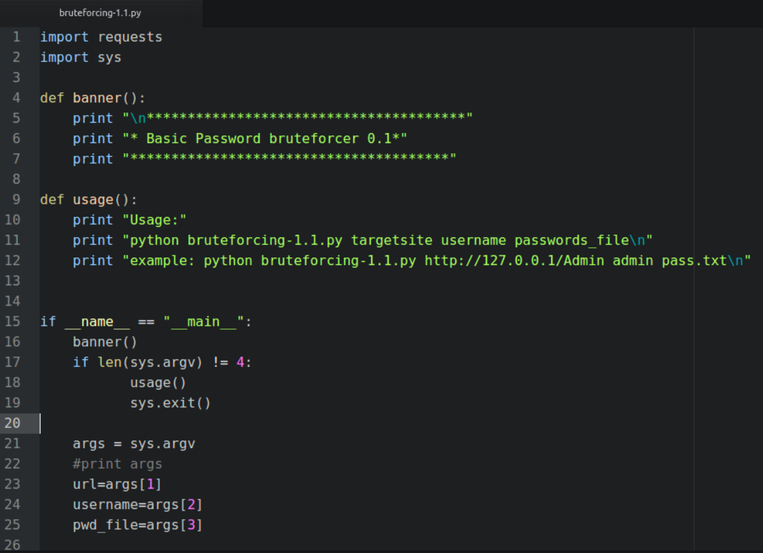
First password tester

Slide 16
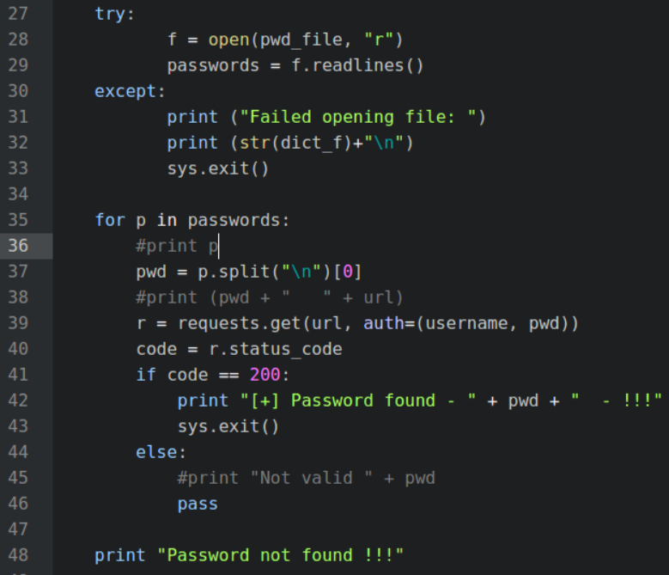
First password tester

Slide 17
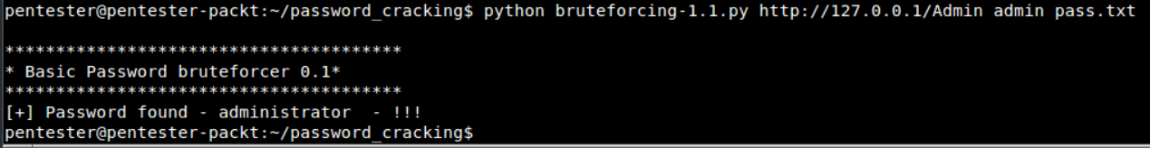
Executing the code

Slide 18
Hands on: Form-based authentication
Most common form of authentication
Login forms: The web application presents a form to request the username and password
Checked at the server side
If the credentials are valid, it will provide a valid session cookie to the user, and it will let the user access the protected resource

Slide 19
Testing form-based authentication
Problem: It is not standardized how to handle authentication on forms
We'll need to have good filtering in order to filter out the wrong attempts and be able to identify the good ones.
For this reason, instead of adding all the filtering code to the previous script, we need to use our code from resource discovery module
Recall that forms for authentication are sent using POST method

Slide 20
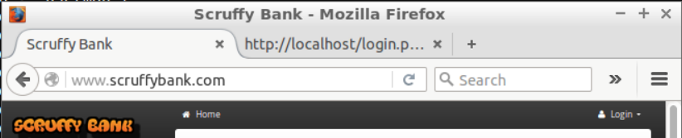
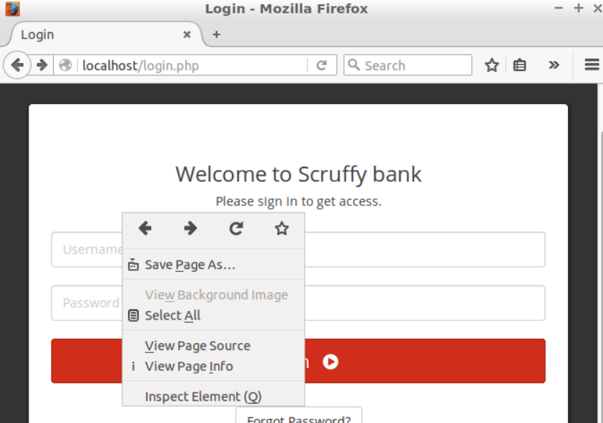
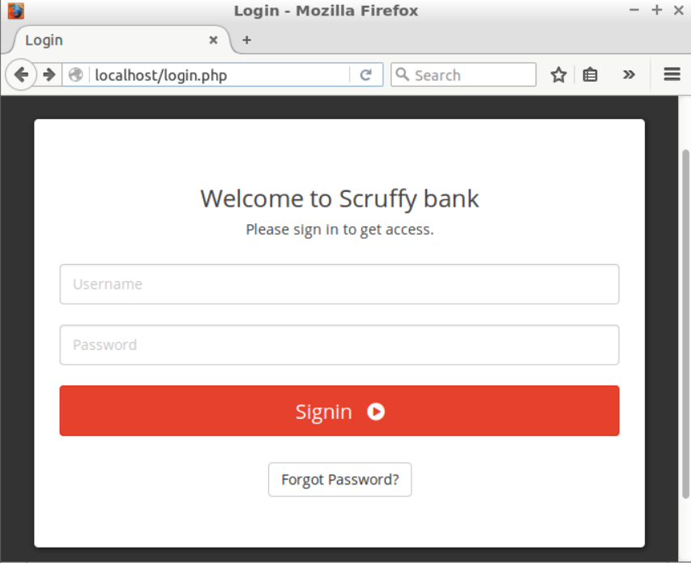
Our test application localhost/login.php

Slide 21
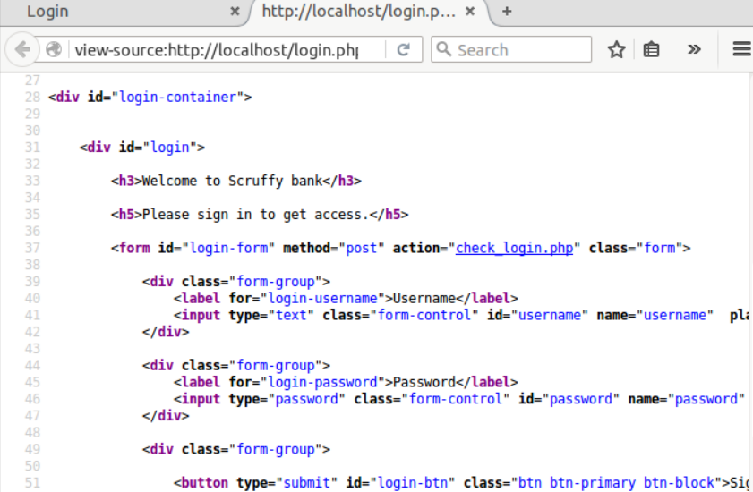
Our test application localhost/login.php
So the address we need to access is:
http://127.0.0.1/check_login.php

Slide 22
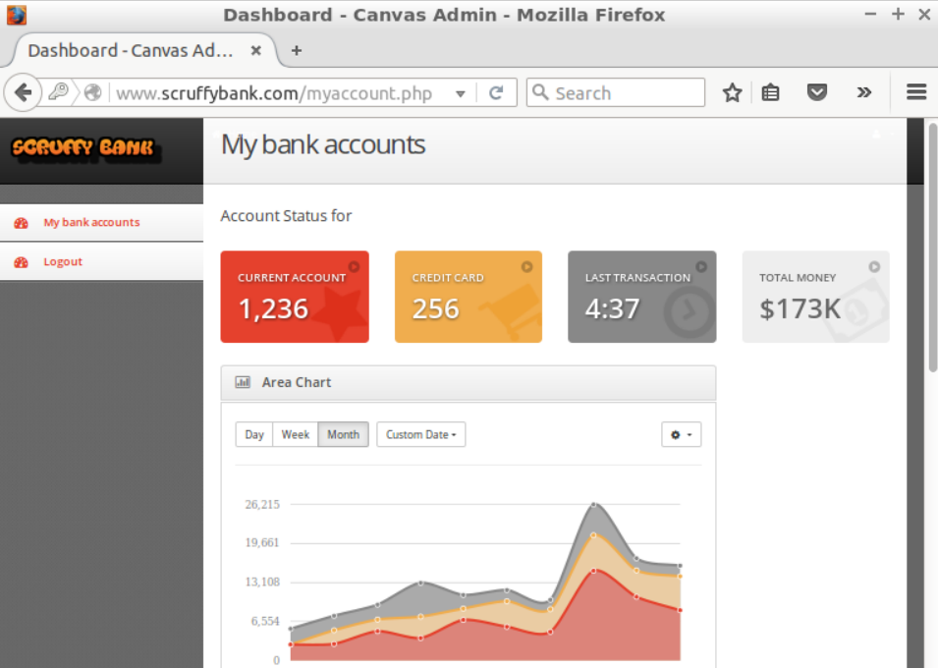
Let us login to the test application localhost/login.php
username: admin
password: administrator123
Redirected to
www.scruffybank.com/myaccount.php

Slide 23
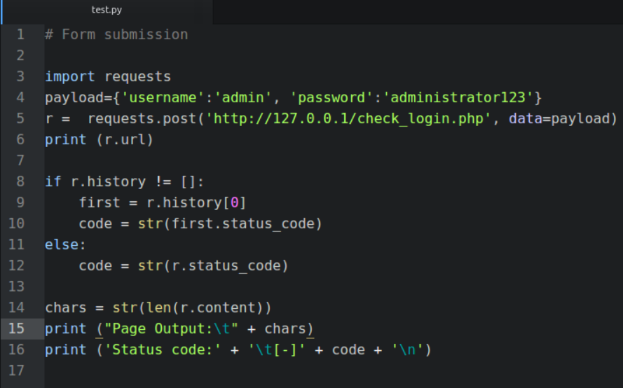
A sample script – test.py
$ python test.py
http://127.0.0.1/myaccount.php
Page Output: 12345
Status code: [-]302

Slide 24
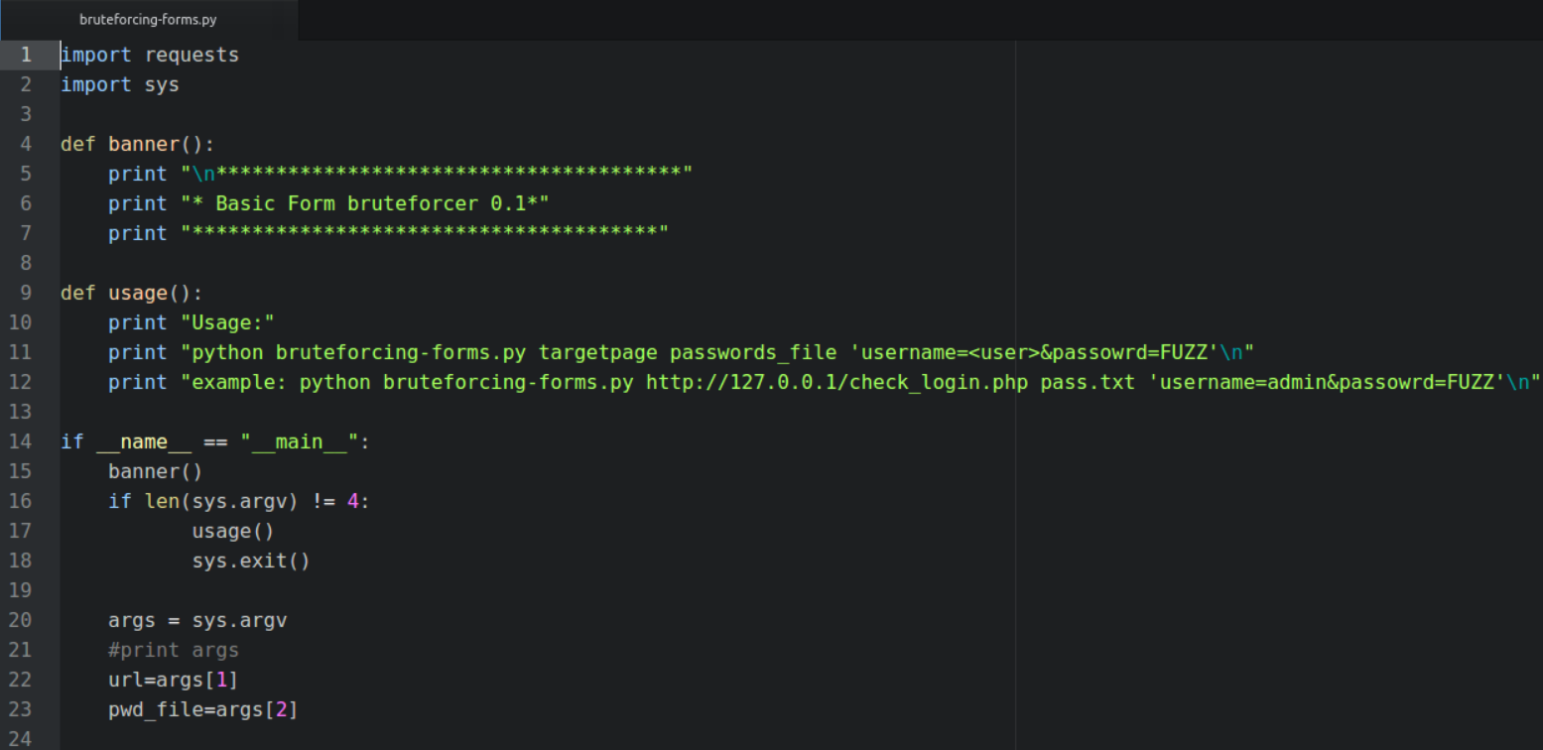
Basic form brute forcer – bruteforcing-forms.py

Slide 25
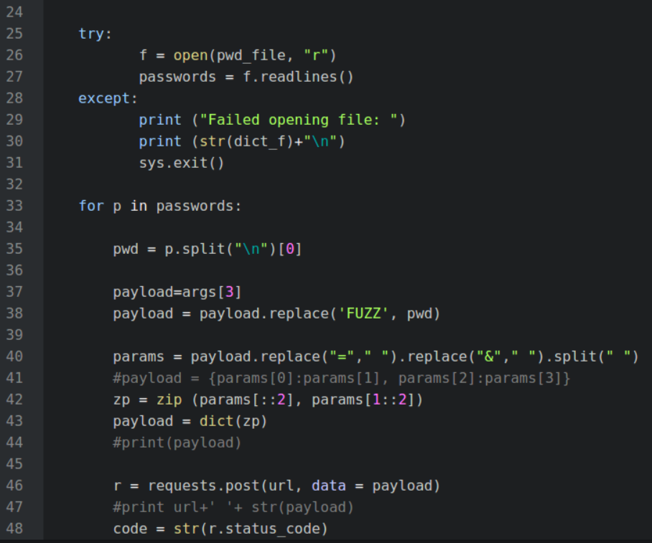
Basic form brute forcer – bruteforcing-forms.py
username=admin&password=FUZZ
username=admin&password=manager
username admin password manager
[username, admin, password, manager]
zip(['username', 'password'], ['admin', 'manager'])
=[('username', 'admin'),('password', 'manager')]
payload={'username':'admin', 'password':‘manager'}

Slide 26
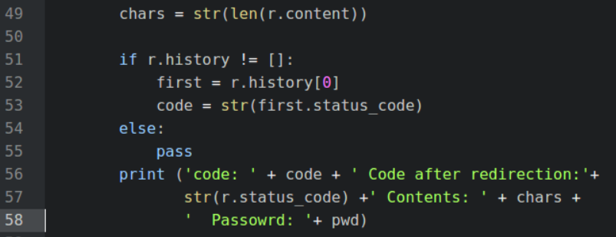
Basic form brute forcer – bruteforcing-forms.py

Slide 27
Basic form brute forcer – output
~/password_cracking$ python bruteforcing-forms.py http://127.0.0.1/check_login.php pass.txt 'username=admin&password=FUZZ'
code: 302 Code after redirection:200 Contents: 2373 Passowrd: userman
code: 302 Code after redirection:200 Contents: 2373 Passowrd: manager
code: 302 Code after redirection:200 Contents: 2373 Passowrd: powerful
code: 302 Code after redirection:200 Contents: 2373 Passowrd: test
code: 302 Code after redirection:200 Contents: 2373 Passowrd: dmin
code: 302 Code after redirection:200 Contents: 2373 Passowrd: asdmini=
code: 302 Code after redirection:200 Contents: 2373 Passowrd: userman
code: 302 Code after redirection:200 Contents: 2373 Passowrd: manager
code: 302 Code after redirection:200 Contents: 2373 Passowrd: powerful
code: 302 Code after redirection:200 Contents: 2373 Passowrd: test
code: 302 Code after redirection:200 Contents: 2373 Passowrd: dmin
code: 302 Code after redirection:200 Contents: 2373 Passowrd: manager
… … … … … … … … … … … … … … … … … … … … … … … … … …
… … … … … … … … … … … … … … … … … … … … … … … … … …
Status code cannot help us to find if some password works
However, all the failed attempts have same number of chars i.e. 2373
We can use it to filter out the failed attempts

Slide 28
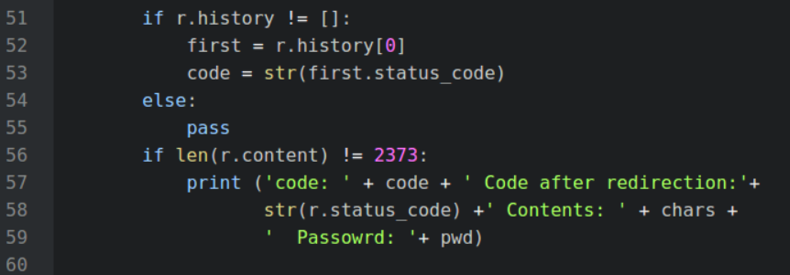
Basic form brute forcer – bruteforcing-forms-final.py
Add the following condition in bruteforcing-forms.py

Slide 29
Basic form brute forcer – output
~/password_cracking$ python bruteforcing-forms-final.py http://127.0.0.1/check_login.php pass.txt 'username=admin&password=FUZZ'
***************************************
* Basic Form bruteforcer 0.1*
***************************************
code: 302 Code after redirection:200 Contents: 12345 Passowrd: administrator123

Slide 30
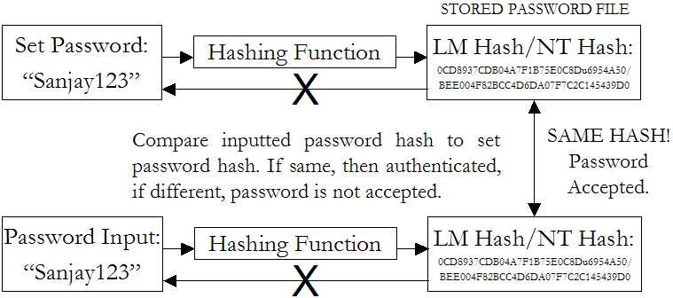
Idea of hashing and its use for password storage
Instead of user password, store hash of password
When user enters password, compute its hash and compare with entry in password file. System does not store actual passwords!

Slide 31
Hash functions
A hash function is any function that can be used to map data of arbitrary size to data of a fixed size
A hash function converts a data (usually string) to a fixed-sized, unique, irreversible number.
Here irreversible means that it is usually very difficult (if not impossible) to convert that number back to the source string.
The value returned by a hash function are called hash values, hash codes, digests, or simply hashes.
Hash function H must have some properties
One-way: given H(password), hard to find password
No known algorithm better than trial and error
Collision-resistant: given H(password1), hard to find password2 such that H(password1)=H(password2)
It should even be hard to find any pair p1,p2 s.t. H(p1)=H(p2)

Slide 32
Unix passwords
Store hashed passwords in /etc/shadow file which is only readable by system administrator (root)
Early Shadow implementations on Linux called the login program which had a buffer overflow!

Slide 33
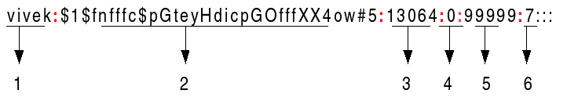
/etc/shadow file fields
Username : It is your login name.
Password : It is your encrypted password. Usually password format is set to $id$salt$hash
Last password change (lastchanged) : Days since Jan 1, 1970 that password was last changed
Minimum : The minimum number of days required between password changes i.e. the number of days left before the user is allowed to change his/her password
Maximum : The maximum number of days the password is valid (after that user is forced to change his/her password)
Warn : The number of days before password is to expire that user is warned that his/her password must be changed
We only care about the first two fields!!!

Slide 34
/etc/shadow file fields
Password : It is your encrypted password. Usually password format is set to $id$salt$hashed.
The $id is the algorithm used On GNU/Linux as follows:
$1$ is MD5
$2a$ is Blowfish
$2y$ is Blowfish
$5$ is SHA-256
$6$ is SHA-512

Slide 36
Additional slides
(only if time permits)

Slide 37
Hands on: Activity on virtual machine (only if time permits)
Copy /etc/shadow
sudo cat /etc/shadow > shadow_file
Extract the line starts with ‘pentester’ (this is our usename on virtual machine)

Slide 38
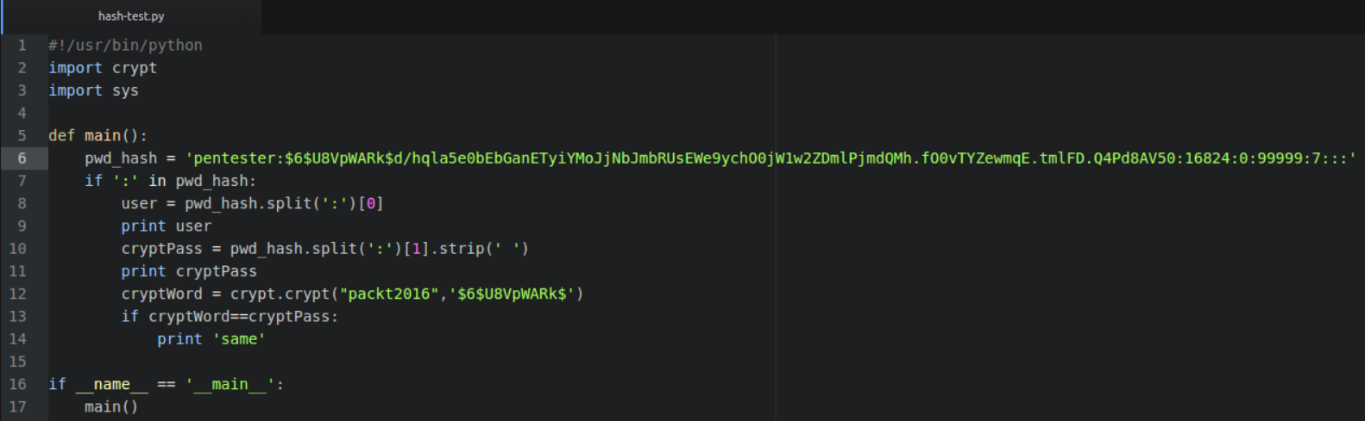
Short program to produce hash for packt2016
user
Salt
Hashed password

Slide 39
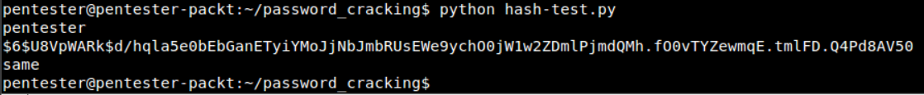

Slide 40
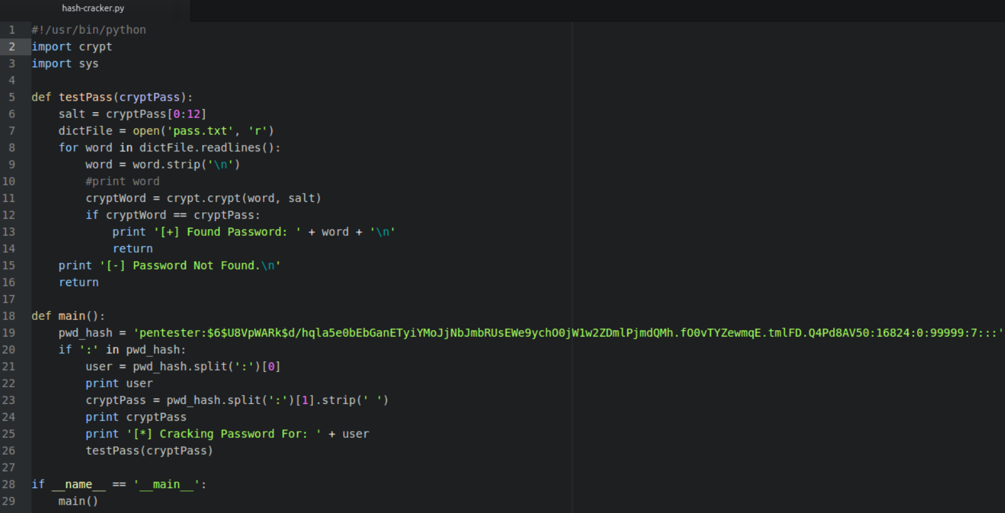
Hands on: The password cracker for Unix
(only if time permits)

Slide 41
